Slide 1

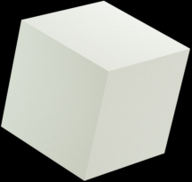




Environment monitoring
using IOT

Slide 2
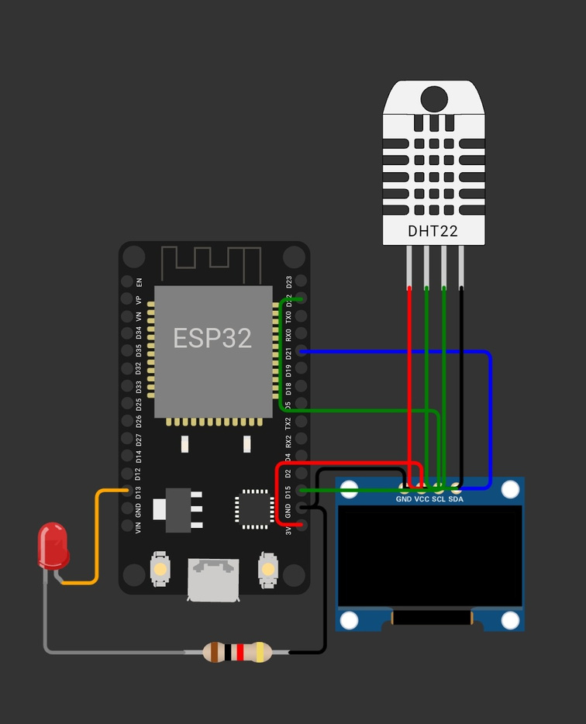
component
Circuit connection
esp32
ole display
dht 11

Slide 3
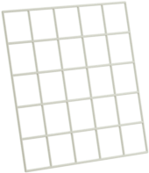

we use a thing speak platform

Slide 4

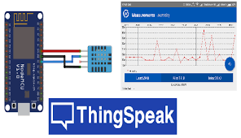

Slide 5
we use a wokwi to simulate
Follow this link
https://wokwi.com/projects/357203527566424065

Slide 6
Presentations are communication tools that can be used.

